Slide 1

Sorting data
Week 6

Slide 2
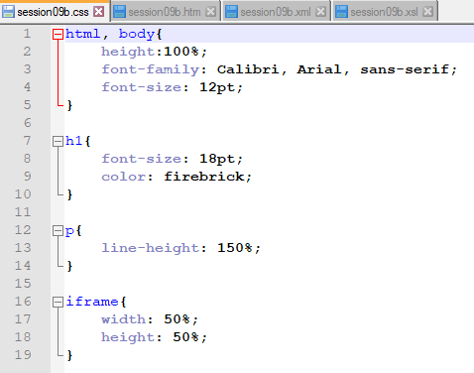
Same css

Slide 3
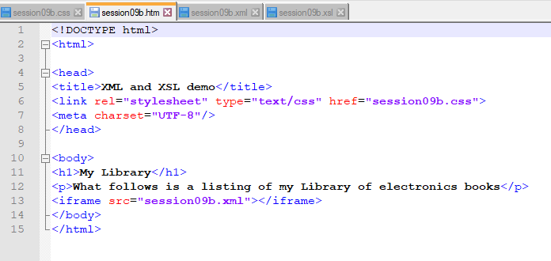

Slide 4
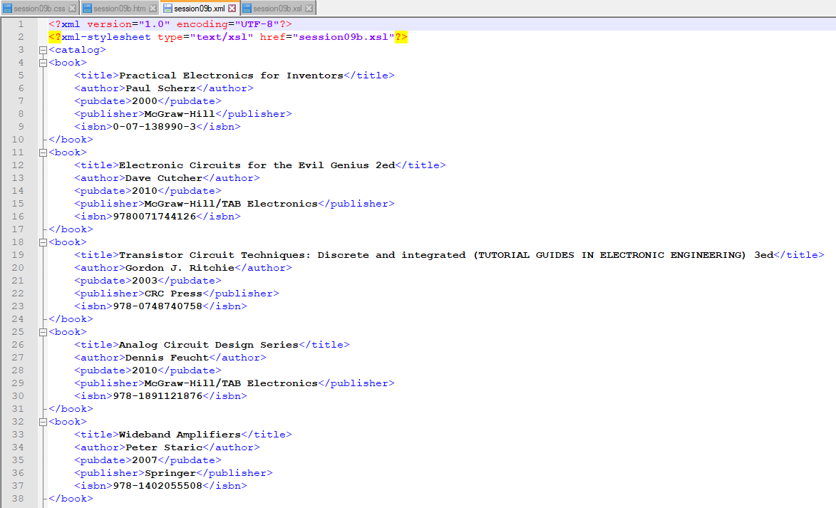

Slide 5


Slide 6
